Slide 1
Adani Wilmar
-A Ecommerce Website
Team Members :
Vishal Reddy
Madhumitha
Hemaharini
Team name :Incognito

Slide 2
Theme :
Consumer digital journey:
Customer onboarding on the application followed by:
Loyalty
Retention
Engagement with existing user
Promotions of products
Innovative Ideas on Promotion cart experience
Existing Users
Prospective users
Cross Sell or upsell
Low cost acquisition (post download app)
Logistics
Route Optimization
Create better experience for delivery
Route Promotions

Slide 3
Tech stack :
01.
02.
03.
Html
CSS
Java Script

Slide 4
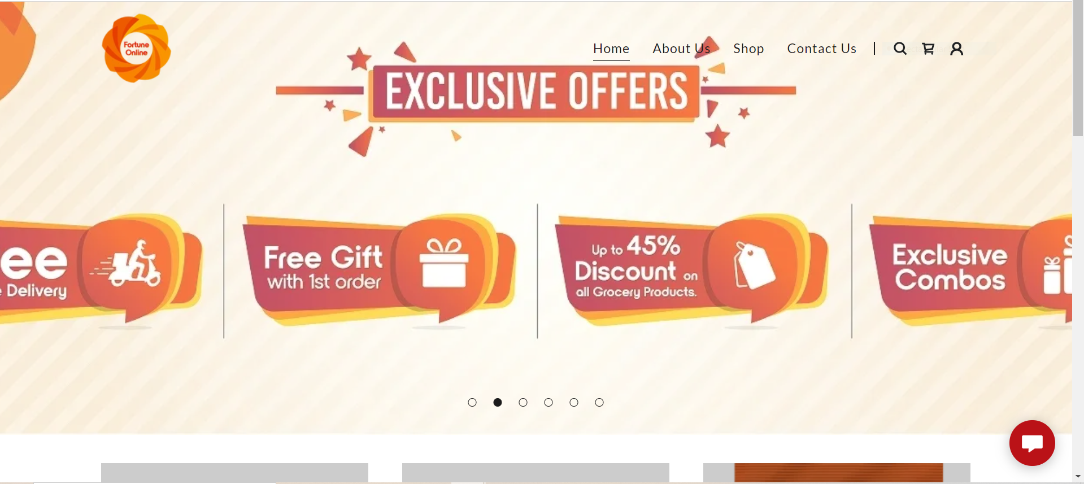
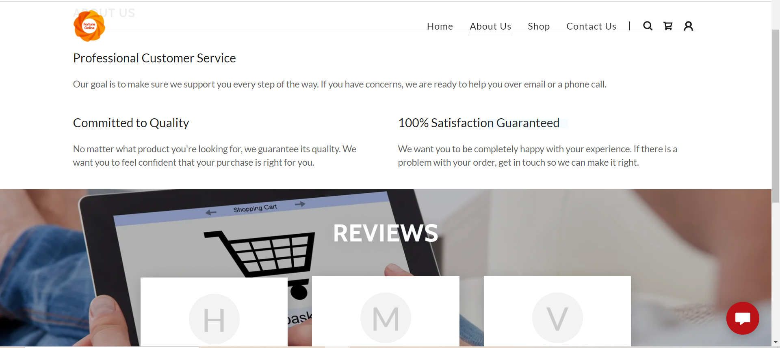
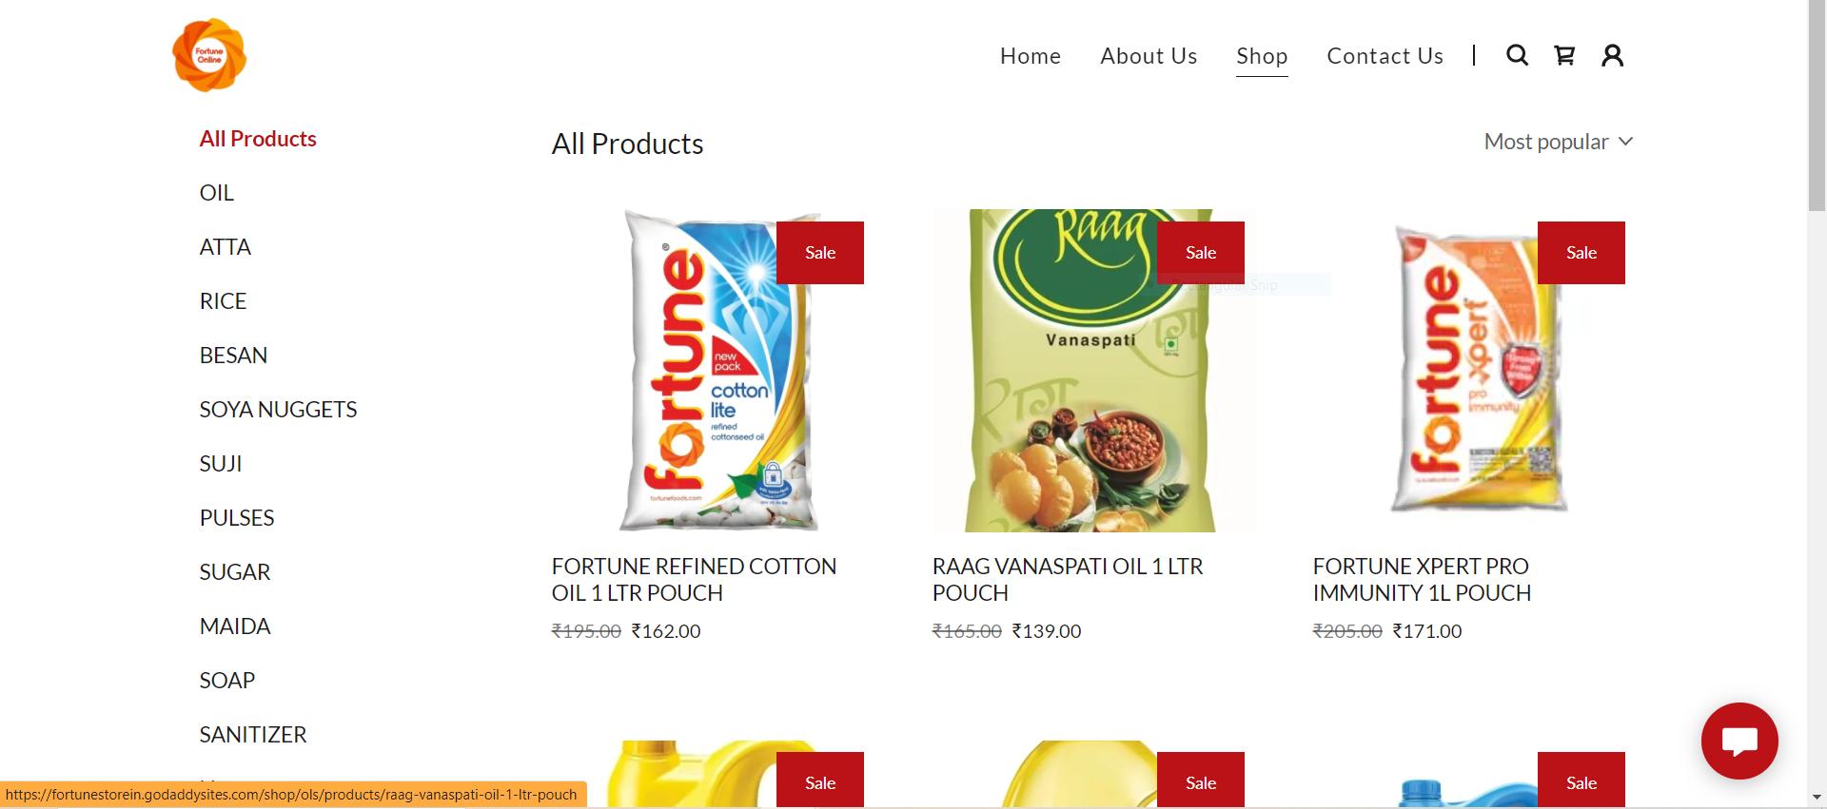
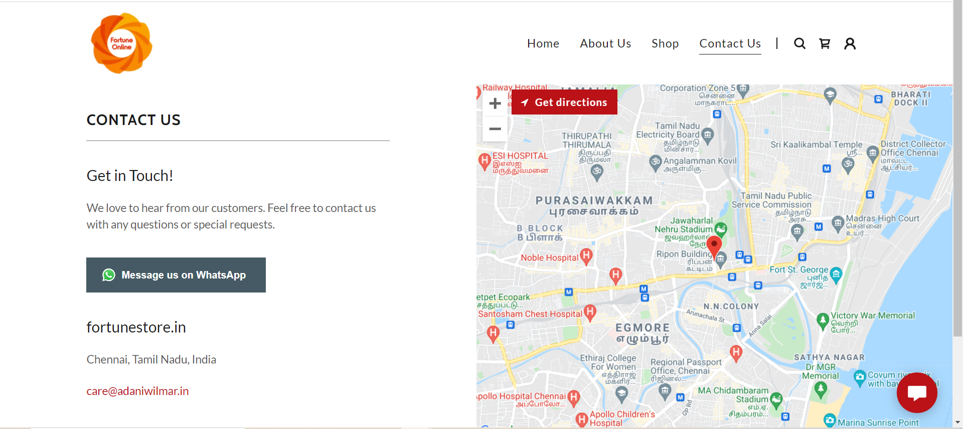

Slide 5
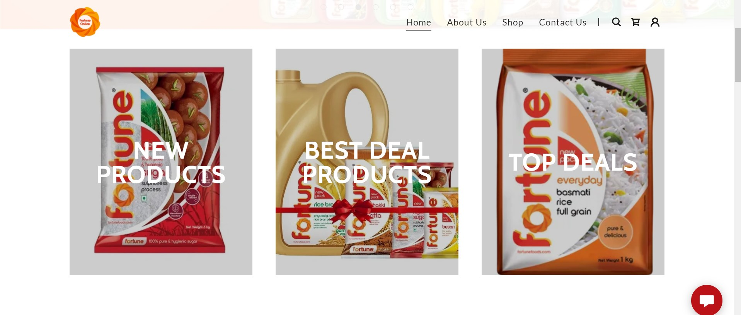
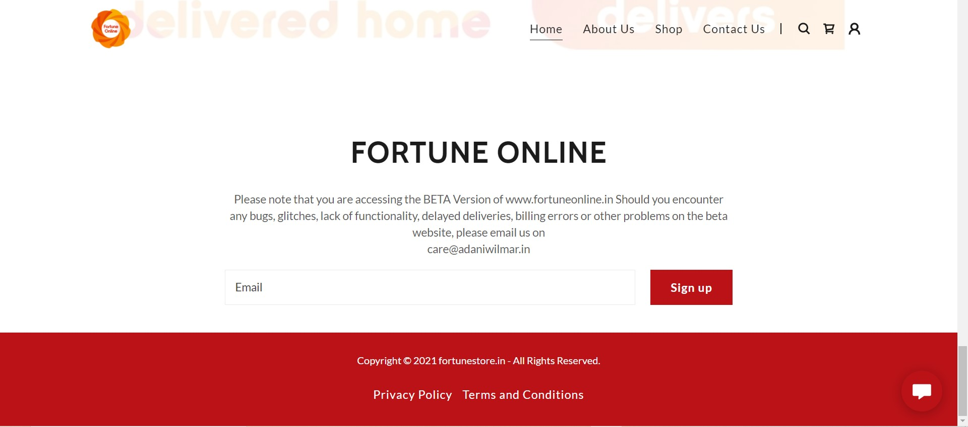
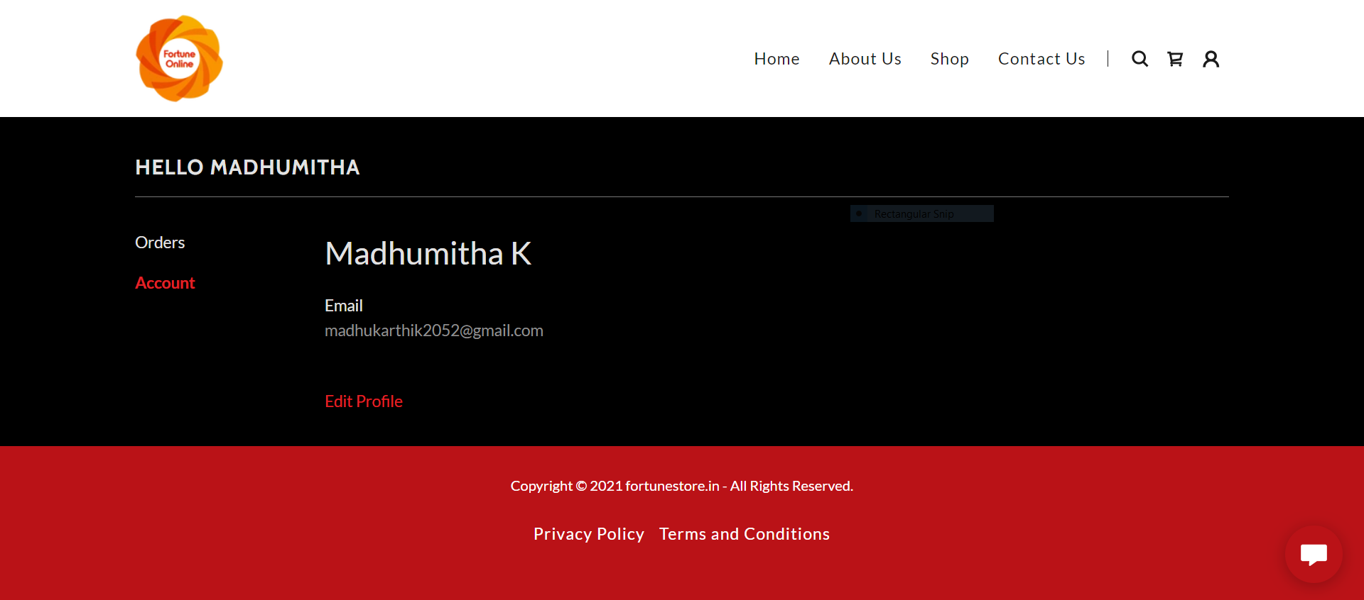

Slide 6
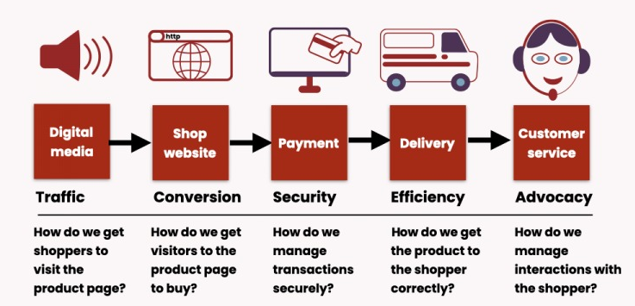
E-Commerce experiences :

Slide 7
Demo video link : https://youtu.be/VK4XHxQVtmE
Github repository link : https://github.com/Hemaharini-SM/Webshop

Slide 8
Thank you

